Slide 1
Extracting a model from our UI needs

Slide 2
Application UI
So we have develop the basic application Ui having the listview with Mock data.
In this video we will setUp UI using our Model class
Notes:
[Mandatory Slide] This would be the introduction slide of the topic that you are covering in this subsection.
When this slide plays, you could talk about the main aim that we’d be covering in this video.

Slide 3
Using Diagrams and Shapes
Step 3
Step 2
Binding Model with View
Step 1
Data Binding
Creat Model Class
Notes:
This is a step-wise graphical info type slide.

Slide 4
Naming In DataBinding!
Notes:
Something that needs to grab the viewers attention!!

Slide 5
Why?
Any Guesses … No!
Model basically used to make our implementation dynamic and Databinding make our code more clean as we don’t need to write glue code any more.
Model And DataBinding

Slide 6
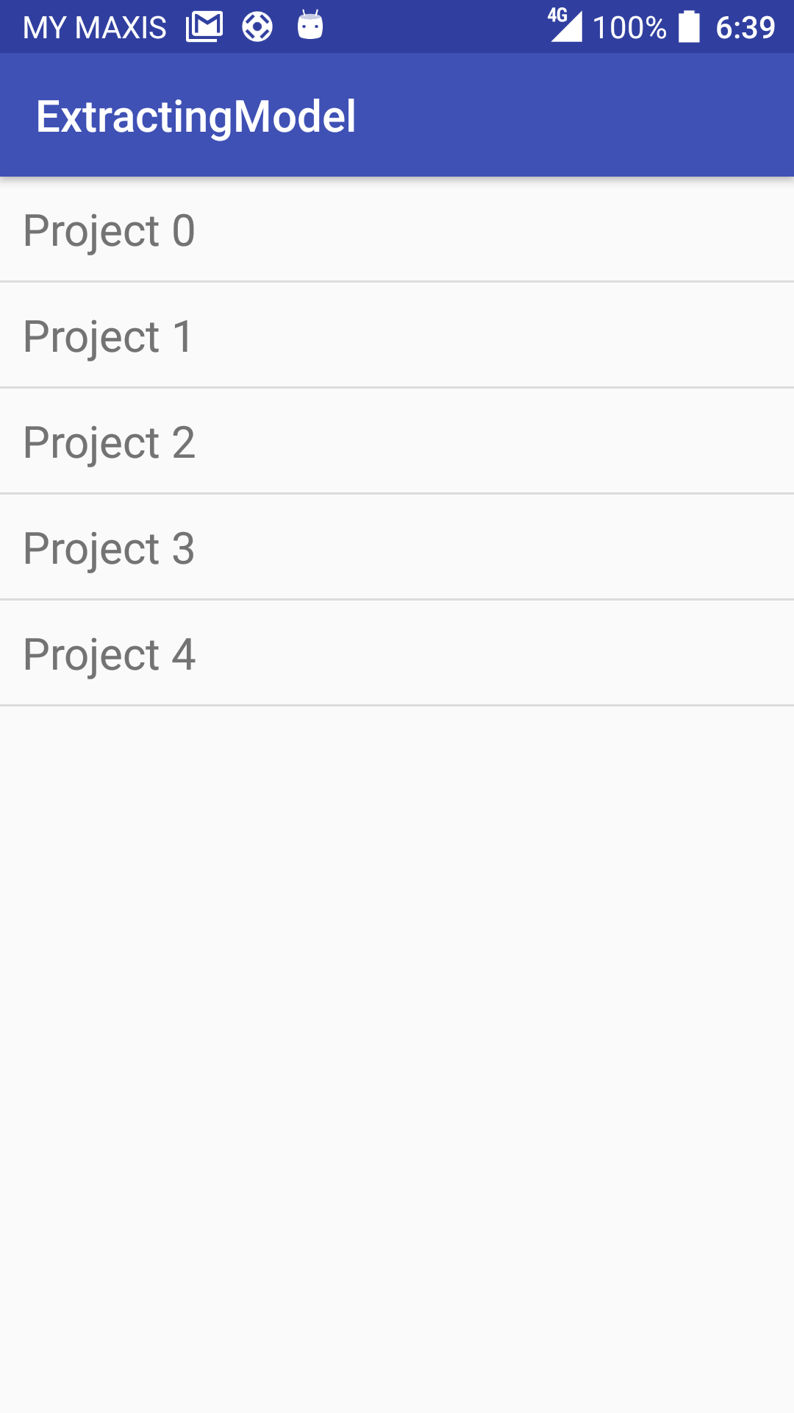
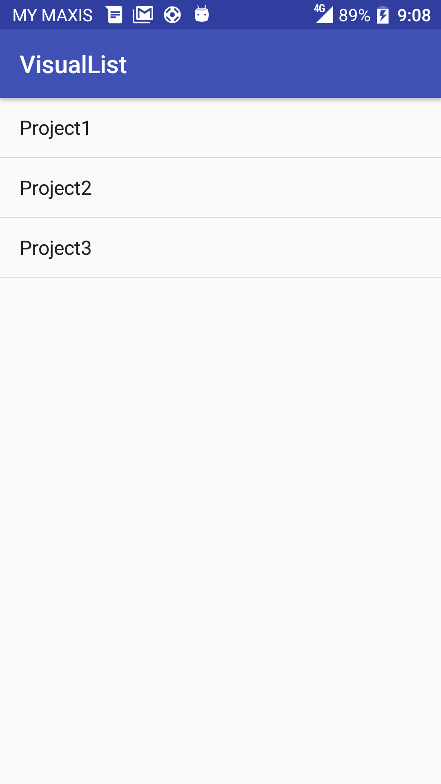
Result

Slide 7
Android Architectural Components: ViewModel and LiveData
Next Video

